Slide 1

CREATING A KUBERNETES CLUSTER WITH KUBEADM

Slide 2
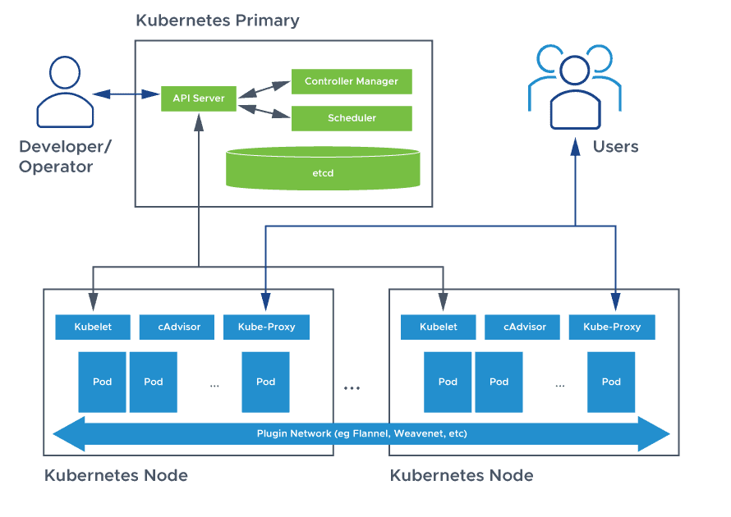

Slide 3
Resources to create
1 ec2 instance control plane ubuntu 20.04 LTS t2.medium
1 ec2 instance node ubuntu 20.04 LTS t2.medium
1 sg for control plane
1 sg for nodes

Slide 4
Security group config control plane
6443/tcp | for Kubernetes API Server
2379-2380 | for etcd server client API
6783/tcp,6784/udp | for Weavenet CNI
10248-10260 | for Kubelet API, Kube-scheduler, Kube-controller-manager, Read-Only Kubelet API, Kubelet health
80,8080,443 | Generic Ports
30000-32767 | for NodePort Services

Slide 5
Security group config nodes
6783/tcp,6784/udp | for Weavenet CNI
10248-10260 | for Kubelet API
30000-32767 | for NodePort Services
80,8080,443 | Generic Ports

Slide 6
Commands to run on control plane and worker node
//disable swap
swapoff -a
sed -i '/ swap / s/^\(.*\)$/#\1/g' /etc/fstab
// install containerd
wget https://github.com/containerd/containerd/releases/download/v1.6.16/containerd-1.6.16-linux-amd64.tar.gz
tar Cxzvf /usr/local containerd-1.6.16-linux-amd64.tar.gz
wget https://raw.githubusercontent.com/containerd/containerd/main/containerd.service
mkdir -p /usr/local/lib/systemd/system
mv containerd.service /usr/local/lib/systemd/system/containerd.service
systemctl daemon-reload
systemctl enable --now containerd

Slide 7
// install runc
wget https://github.com/opencontainers/runc/releases/download/v1.1.4/runc.amd64
install -m 755 runc.amd64 /usr/local/sbin/runc
// install CNI
wget https://github.com/containernetworking/plugins/releases/download/v1.2.0/cni-plugins-linux-amd64-v1.2.0.tgz
mkdir -p /opt/cni/bin
tar Cxzvf /opt/cni/bin cni-plugins-linux-amd64-v1.2.0.tgz
// install CRICTL
VERSION="v1.26.0" # check latest version in /releases page
wget https://github.com/kubernetes-sigs/cri-tools/releases/download/$VERSION/crictl-$VERSION-linux-amd64.tar.gz
sudo tar zxvf crictl-$VERSION-linux-amd64.tar.gz -C /usr/local/bin
rm -f crictl-$VERSION-linux-amd64.tar.gz

Slide 8
cat <<EOF | sudo tee /etc/crictl.yaml
runtime-endpoint: unix:///run/containerd/containerd.sock
image-endpoint: unix:///run/containerd/containerd.sock
timeout: 2
debug: false
pull-image-on-create: false
EOF
// Forwarding IPv4 and letting iptables see bridged traffic
cat <<EOF | sudo tee /etc/modules-load.d/k8s.conf
overlay
br_netfilter
EOF
sudo modprobe overlay
sudo modprobe br_netfilter
cat <<EOF | sudo tee /etc/sysctl.d/k8s.conf
net.bridge.bridge-nf-call-iptables = 1
net.bridge.bridge-nf-call-ip6tables = 1
net.ipv4.ip_forward = 1
EOF

Slide 9
sudo sysctl --system
sysctl net.bridge.bridge-nf-call-iptables net.bridge.bridge-nf-call-ip6tables net.ipv4.ip_forward
modprobe br_netfilter
sysctl -p /etc/sysctl.conf
// install kubectl, kubelet and kubeadm
apt-get update && sudo apt-get install -y apt-transport-https curl
curl -s https://packages.cloud.google.com/apt/doc/apt-key.gpg | sudo apt-key add -
cat <<EOF | sudo tee /etc/apt/sources.list.d/kubernetes.list
deb https://apt.kubernetes.io/ kubernetes-xenial main
EOF
apt update -y
apt install -y kubelet kubeadm kubectl
sudo apt-mark hold kubelet kubeadm kubectl
sudo apt-mark hold kubelet kubeadm kubectl

Slide 10
Run on master
kubeadm config images pull
kubeadm init --control-plane-endpoint "PUBLIC_IP:6443"
// install CNI plugin
kubectl apply -f https://github.com/weaveworks/weave/releases/download/v2.8.1/weave-daemonset-k8s.yaml

Slide 11
Run on nodes
Run the join command obtained from kubeadm init output on all Workers nodes. Example
kubeadm join \ 192.168.56.2:6443 --token … --discovery-token-ca-cert-hash sha256 . . . .

Slide 12
Connect to cluster from local
Copy the content of the kubeconfig from ~/.kube/config
And create same folder locally
- for linux ~/.kube/config and paste the content inside
- for windows C:\Users\user-name\.kube\config where user-name is your windows user name
- run
Kubectl config use-context context-name
Where context-name in the name of the context in the .kube/config file

